Slide 1

Digital Equity in Arlington
Aug 19th, 2020
A Forum on Equity: Municipal broadband and broadband access

Slide 2
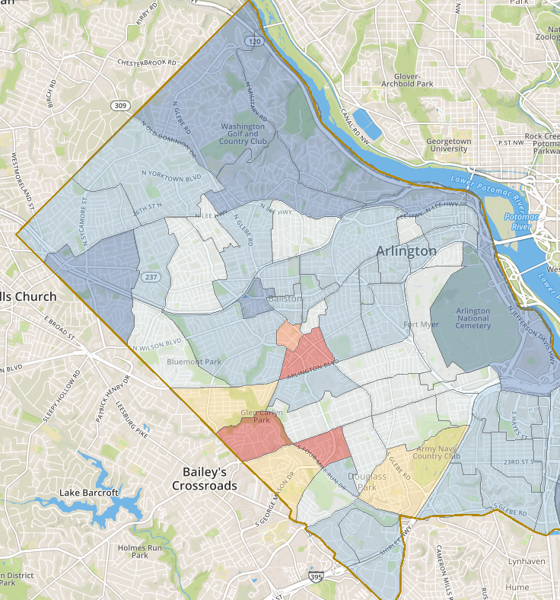
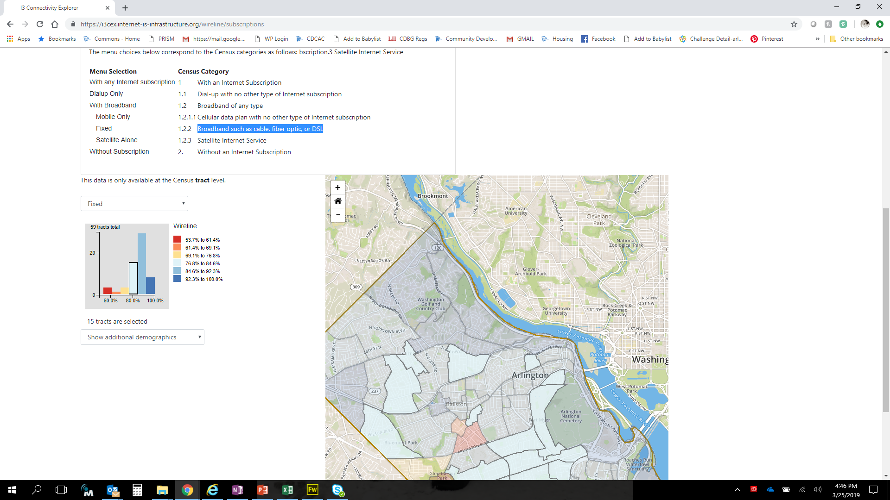
Where Does the disparity exist?
Census tracts with the lowest fixed home broadband adoptions rates correlate to Arlington’s low- and moderate- income neighborhoods (Arlington Mill, Buckingham, Green Valley, Columbia Heights West, Douglas Park, Columbia Forest)
59 tracts total
53.7% to 61.4%
61.4% to 69.1%
69.1% to 76.8%
76.8% to 84.6%
84.6% to 92.3%
92.3% to 100.0%
Source: U.S. Census Bureau’s [2013-2017] American Community Survey 5-year estimates
Notes:
Holly

Slide 3
Digital Divide in Arlington
Types of Household Internet Subscriptions
90% of Arlington households have some type of internet subscription (cellular, satellite, cable, fiber optic, or DSL).
16% of households do not have access to a fixed home broadband internet connection (cable, fiber optic or DSL).
Source: U.S. Census Bureau’s [2013-2017] American Community Survey 5-year estimates
*Total households without internet only

Slide 4
Digital Divide in Arlington
Internet Subscription Disparities
Residents at greater risk:
  Older adults(65+)
  African American and Hispanic individuals
  With less than a high school education
  Low-income
49% of households lacking home internet subscription are Hispanic or African American
54% of households lacking a home internet subscription make less than $75k
Source: U.S. Census Bureau’s [2013-2017] American Community Survey 5-year estimates
*Total households without internet only

Slide 5
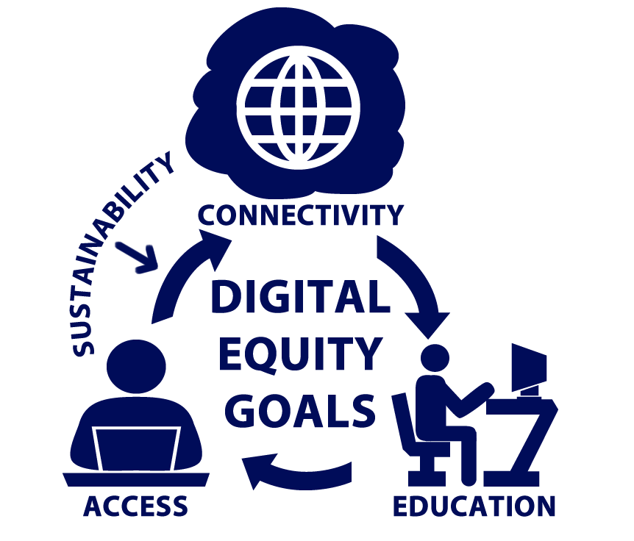
Arlington's Vision for Digital Equity
All Arlingtonians have the information technology capacity needed to fully participate in the community and economy.
Strategies will address:
CONNECTIVITY: Arlington residents are able to connect to affordable broadband internet.
ACCESS: All residents can access the internet with a device.
EDUCATION & TRAINING: Residents have the appropriate digital skills necessary to be successful on the internet.
PROGRAM SUSTAINABILITY & COMMUNITY CAPACITY: Arlington’s strategies to achieve its digital equity goals are sustainable and the community is engaged on the issue.

Slide 6
Progress Updates – Community Engagement
Task Action | Purpose
Published Digital Equity Website | Provide public with a single point of information for Digital Equity efforts.
Engaged Innovation Team on Digital Equity Resource Map | Provide tool to support awareness of digital resources to vulnerable populations
Communicated efforts to Commissions: ITAC, Tenant-Landlord and Housing Commission, Commission on Aging and Disabilities | Raise awareness and gather input
Creation of the Digital Inclusion Network | Provide opportunity for interested parties who serve community to provide feedback
Engaged Contractor on Focus Groups and Survey | Engage and incorporate feedback into Action Plan from impacted populations
Notes:
Speaking = Holly

Slide 7
Progress Updates - Summary Of Initiatives
Initiative | Purpose | Population Impacted
Mary Marshall Process Adjustments | Improve dental & admittance processing | 50 dental, 2 – 3 admits per year
RPC Audio Visual Install | AV to improve training and admin support | 100 a year
Free Clinic Connection to VHC | Serve as a platform to improve outcomes for individuals w/o Medicaid | 1,600 patients a year
Culpepper Grant | Test innovations to improve health and wellbeing of older adults | TBD
Digital Inclusion Network & Website | Gather input and share progress | Network of 100+ interested people
Wi-Fi Hotspots | Extend Wireless Connectivity in disadvantaged areas | Avg 2,000+ Connections a week @ 5 advertised hotspots
Survey and Focus Groups | Gather input from impacted individuals | 228 participants
Notes:
Construction starting at Columbia Pike Aug 1 through the fall. CPRO is interested in keeping the space open and plans on using it for drive in movies. Keep open for now but monitor activity and consider turning it off at some point during the construction. It can be turned back on after completed.

Slide 8
Progress Updates - Summary Of Initiatives
Initiative | Purpose | Population Impacted
Library mybook | Access to hard copy books | Eligible K-2 APS students
Library Online engagements | Increase digital skills | All library patrons
APS Comcast Internet Essentials | Participate in distance learning and support family needs | 8,083 FARM children for the 20-21 school year
Nonprofit Feasibility Study | Research costs of connectivity to affordable housing through a nonprofit | Residents of affordable housing properties
Notes:
Construction starting at Columbia Pike Aug 1 through the fall. CPRO is interested in keeping the space open and plans on using it for drive in movies. Keep open for now but monitor activity and consider turning it off at some point during the construction. It can be turned back on after completed.

Slide 9
Summary Of Planned Initiatives
Initiative | Purpose | Population Impacted
Wi-Fi Hotspot expansion | Extend Wi-Fi access geographically and add signage to existing spots | ~15+ additional planned sites
Implement solution to provide affordable internet access to all affordable housing | Support universal connectivity for underserved County residents. | 8300+ households
Complete Digital Equity Action Plan (DEAP) | Provide a policy framework with defined action steps and strategies to align funding and priorities | All Residents
Implement Action Steps aligned with DEAP | All Arlingtonians have the information technology capacity needed to fully participate in the community and economy. | All Residents
Notes:
Construction starting at Columbia Pike Aug 1 through the fall. CPRO is interested in keeping the space open and plans on using it for drive in movies. Keep open for now but monitor activity and consider turning it off at some point during the construction. It can be turned back on after completed.

Slide 10
Contact
Holly Hartell hhartell@arlingtonva.us
Arlington Digital Equity Website:
https://departments.arlingtonva.us/dts/digital-equity/
Notes:
Construction starting at Columbia Pike Aug 1 through the fall. CPRO is interested in keeping the space open and plans on using it for drive in movies. Keep open for now but monitor activity and consider turning it off at some point during the construction. It can be turned back on after completed.

Slide 11

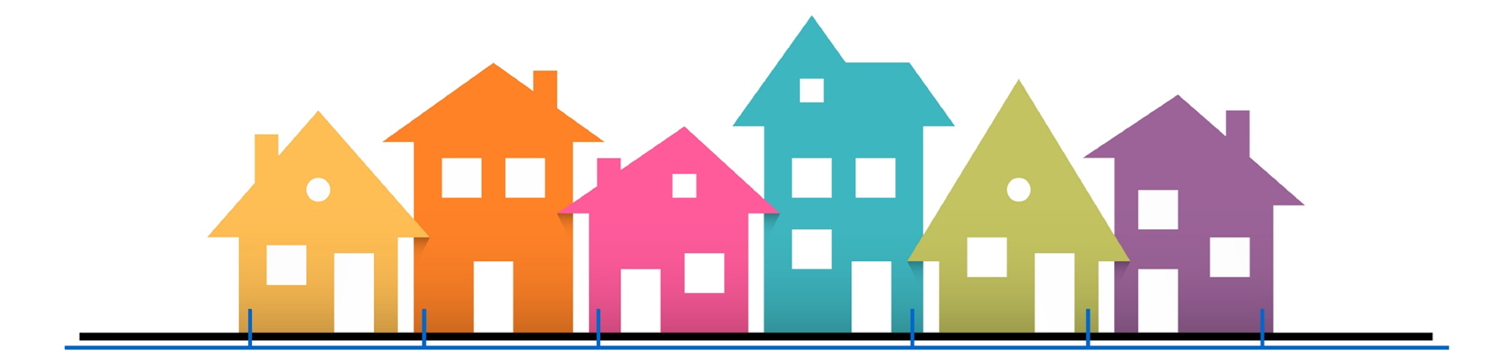
Bruce Patterson
Technology Director for the City of Ammon, Idaho
bpatterson@ammonfiber.com

Slide 12
Open Access Infrastructure Provider
Internet Packages:
15/15Mbps $16.50 per month
1Gbps $26.50 per month

Slide 13
The Ammon Model
Key Challenges:
1 - Authority
2 - Economics

Slide 14
Resulting Model:
True Infrastructure Utility:
    Cost of Recovery
    (not for profit or rate of return)
    Municipal Bond Financing
    Costs Paid by Property Owner
    (no municipal debt)

Slide 15
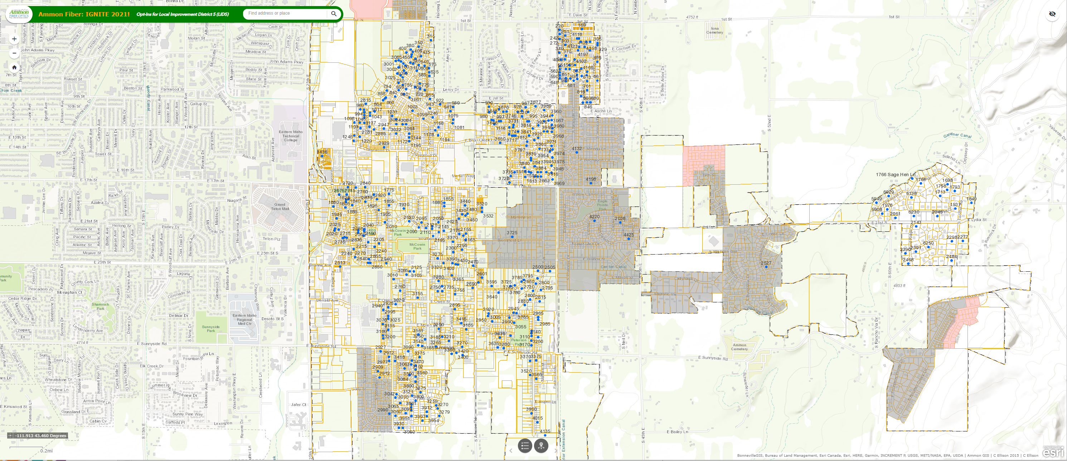
Community Driven

Slide 16
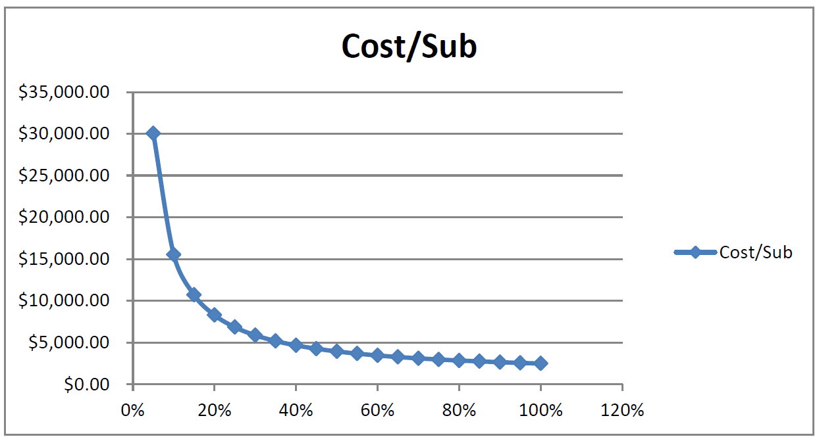
The Importance of Demand

Slide 17

The Importance of Competition
Year 1 (2016) – 1 Gigabit $99 - $109
Year 3 (2019) – 1 Gigabit $9.99 - $25

Slide 18
Lessons Learned:
1 – No improvement w/o participation
2 – Need a path to invest in outcome
3 – You can do it!

Slide 19
Bruce Patterson
Technology Director for the City of Ammon, Idaho
bpatterson@ammonfiber.com

